Slide 1
DBTF Analysis - August

Slide 2
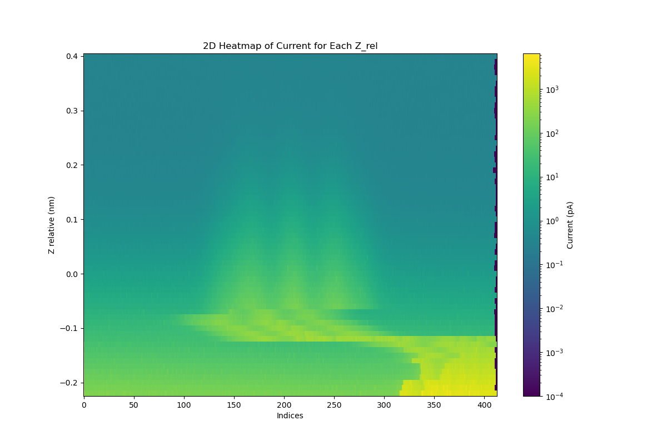
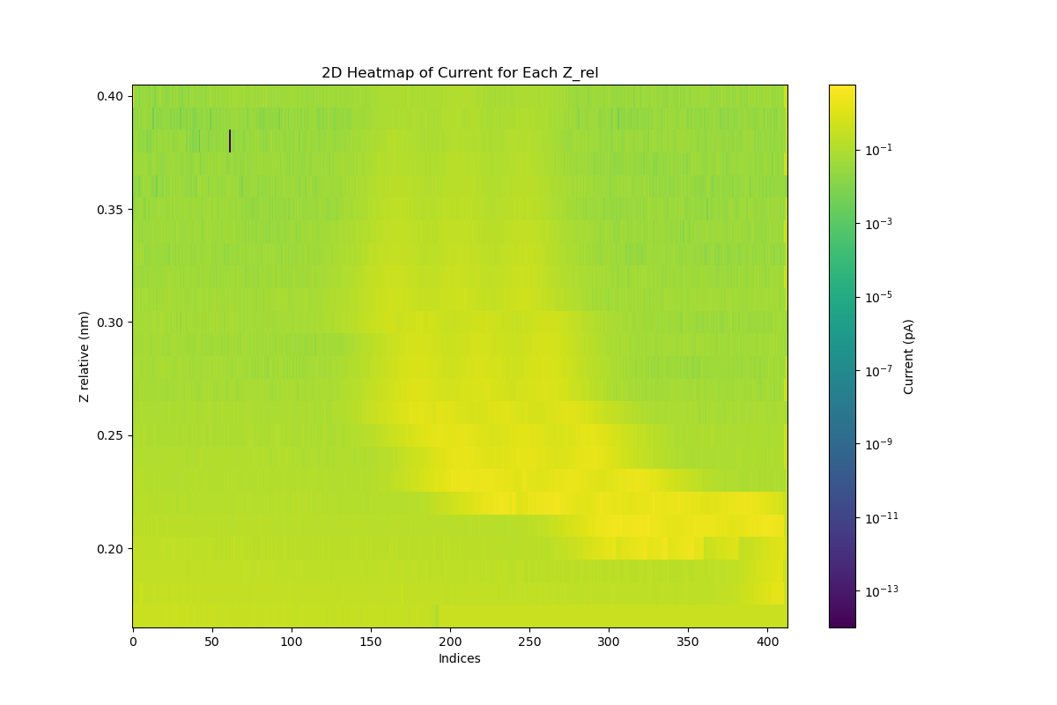
Force analysis – Recreating the data maps that Brian did first (Current)

Slide 3
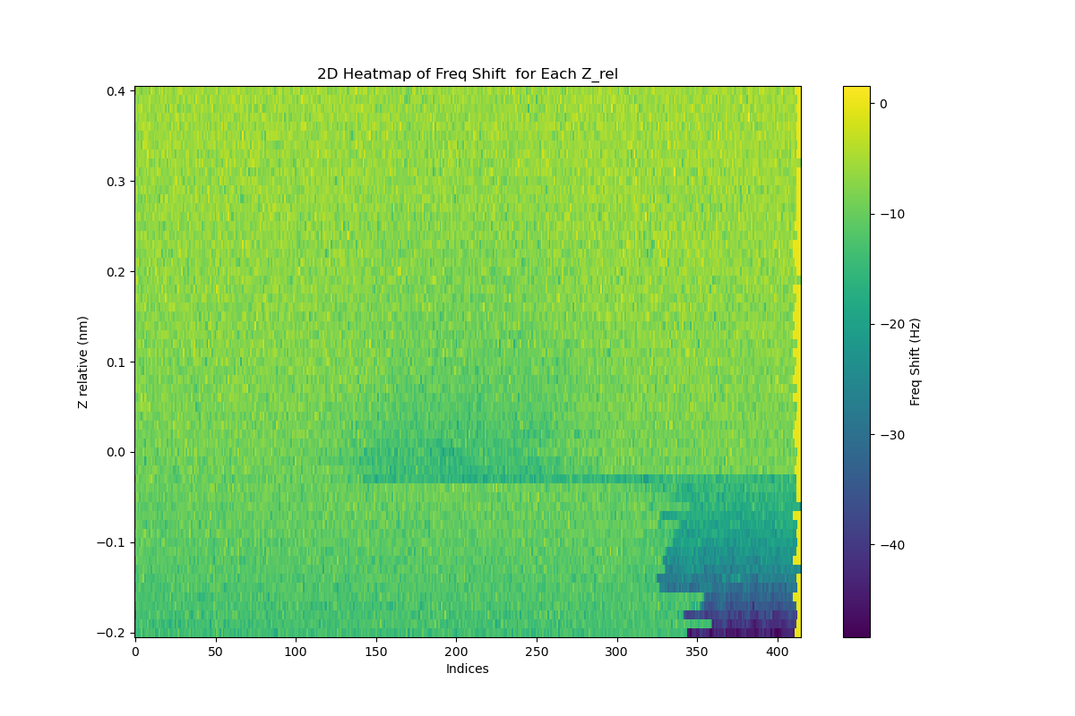
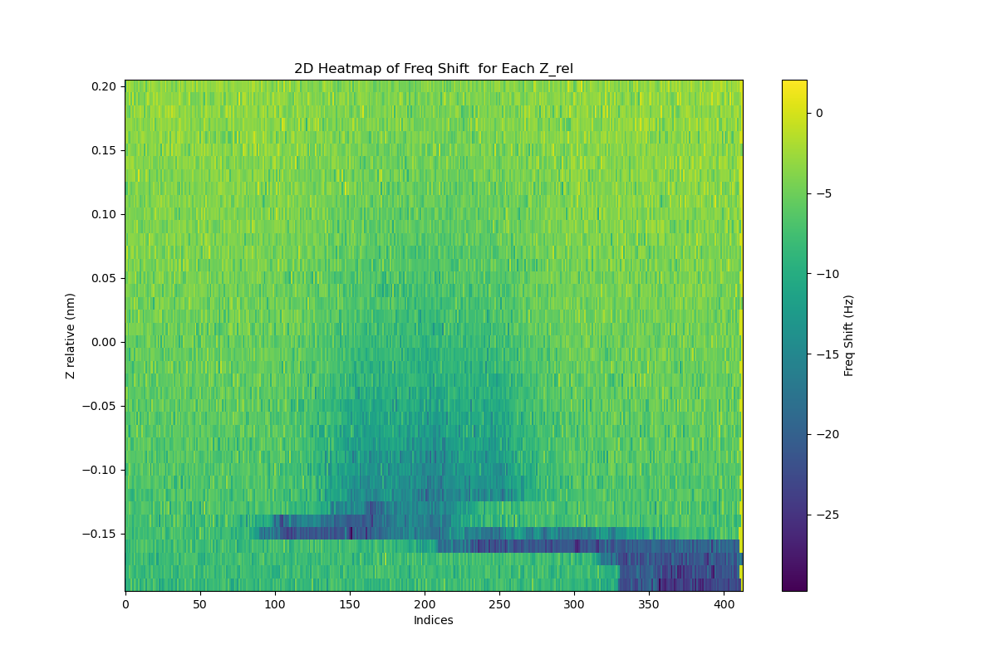
Force analysis – Recreating the data maps that Brian did first (Freq_shift)

Slide 4
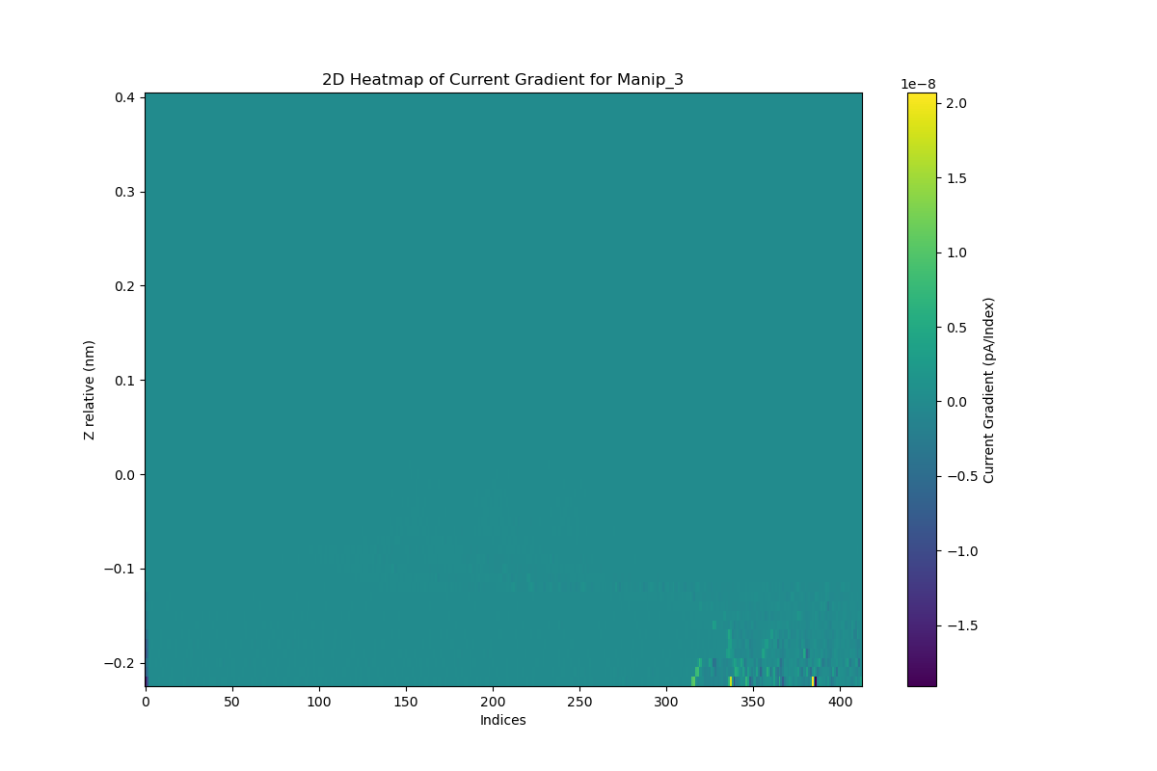

What happens if we differentiate those images? Just do a normal one
There is something just not much ya know. Maybe a valid way to find something...

Slide 5
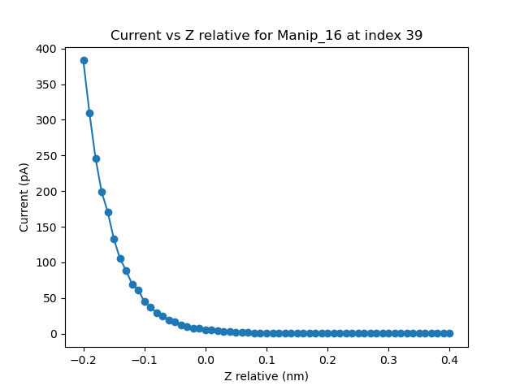
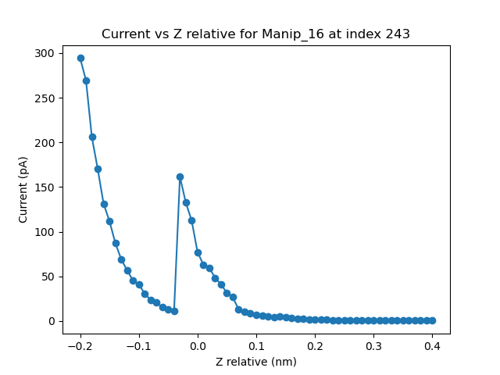
Okay time to start doing these df(z) esque things. Plot each column of the matrix basically
It works! Time to actually try and make sense of this bloody thing. Done it for current and df so hopefully we see some stuff. We’re looking for discontuities right? -> Clear shift in current for second movement but not really for first.

Slide 6
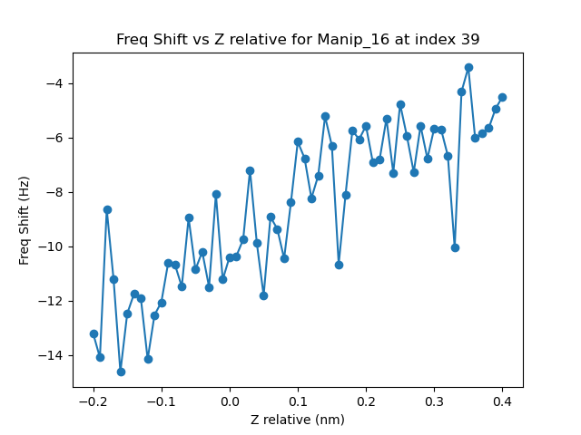
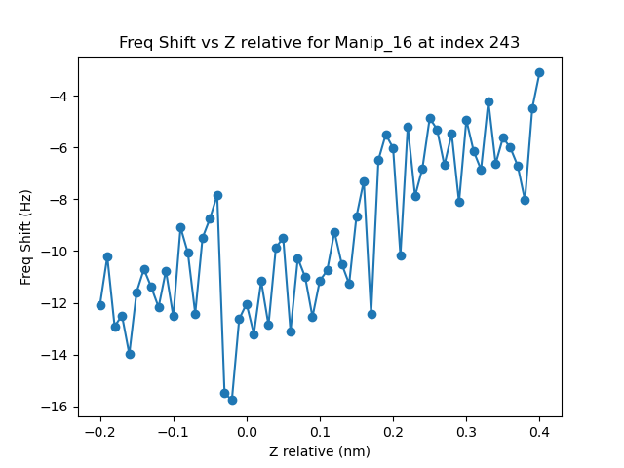
Lot harder to see in dF just based on noise. It does show up but it’s a lot less convincing that current. I guess these will start to be seder jarvised?

Slide 7
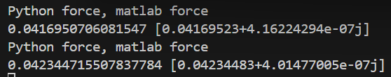
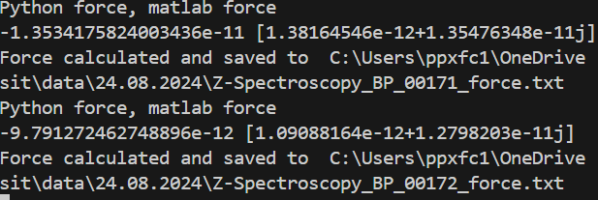
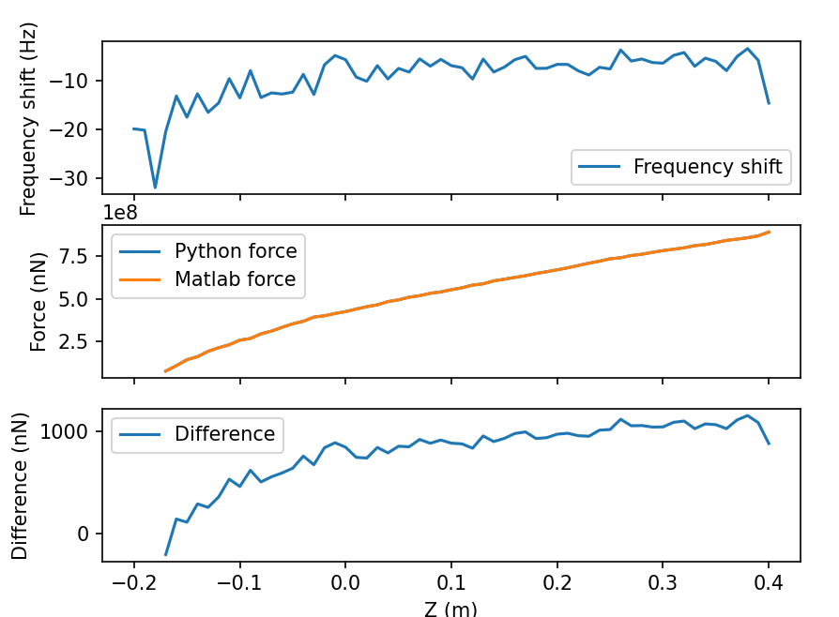
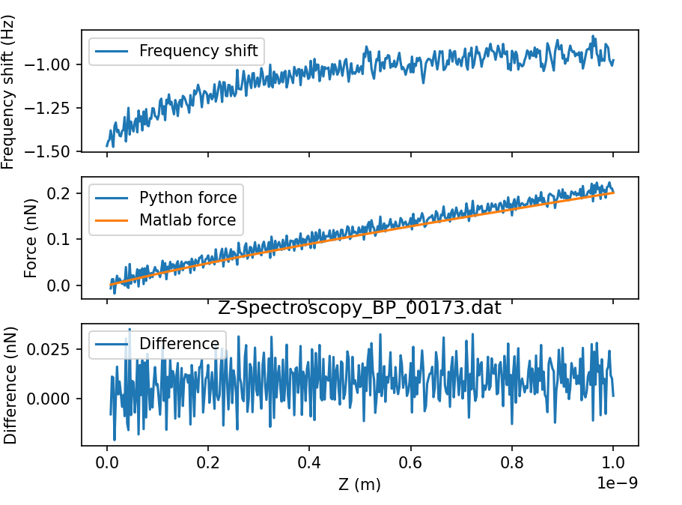
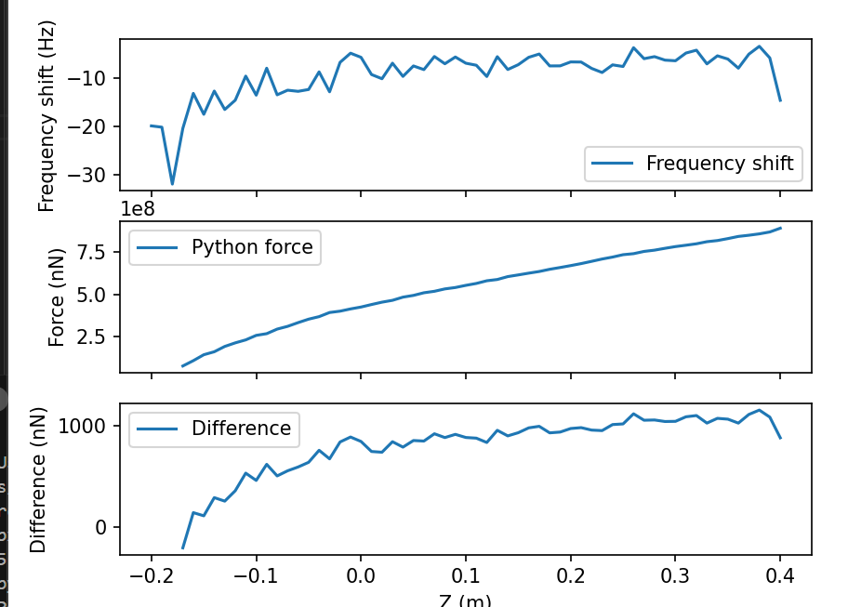
Seeing large differences in python and matlab compared to the previous code (off by 5 oom rather than 1-2 order of a
Now I may be an idiot but the lines don’t look too bad? I’m an idiot that + is just after so I’m confused by the 1000nN difference towards the end

Slide 8
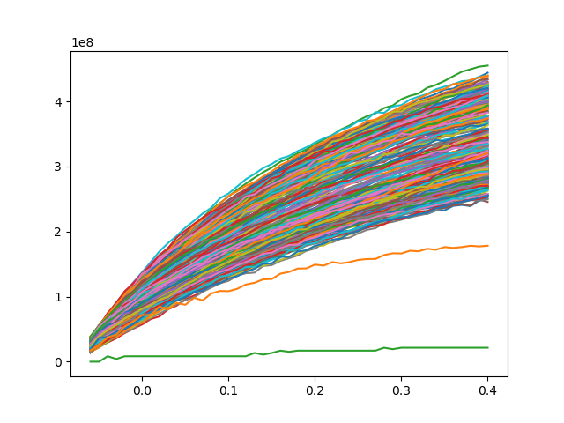
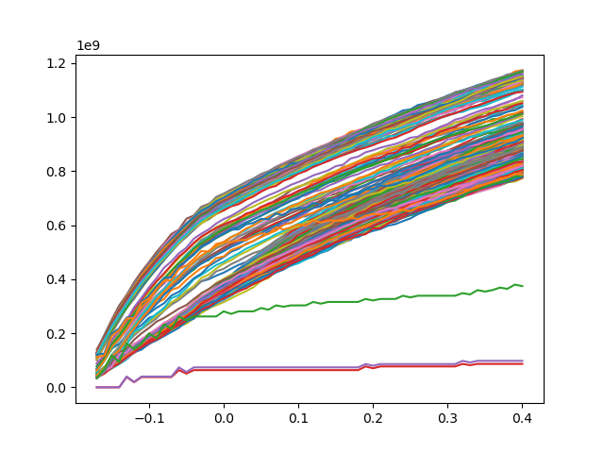
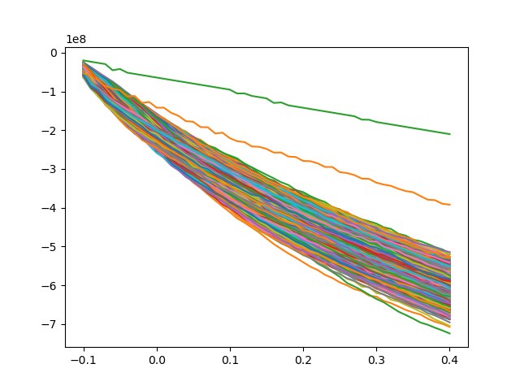
Will plot all of them currently and then plot all the pyforce’s on top of each other and see the result.
Initial manip 16 – Why is force getting less as you go in? Try absing the matrix to see if it’s a problem with a negative df
Manip 10 – 0V so negative current and it goes the right direction
Manip4 -> Same bias as 16 but just at 330mk not 2k… force is an oom higher? WHICH MAKES SENSE OMG THAT’S FUCKING AMAZING

Slide 9
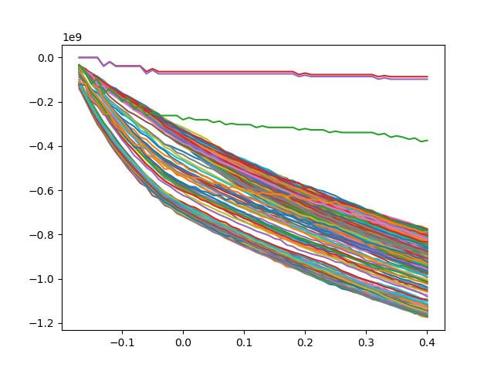
Found the absolute valuve of df signal and the force flipped. Now checking to see if just changing the sign works

Slide 10
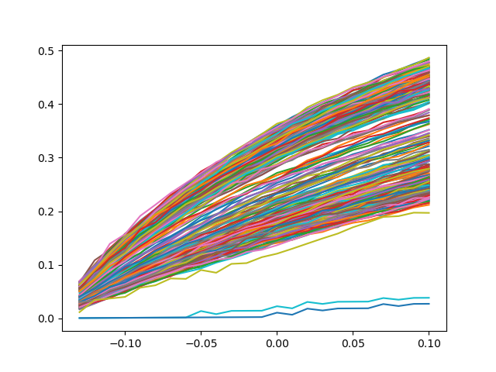
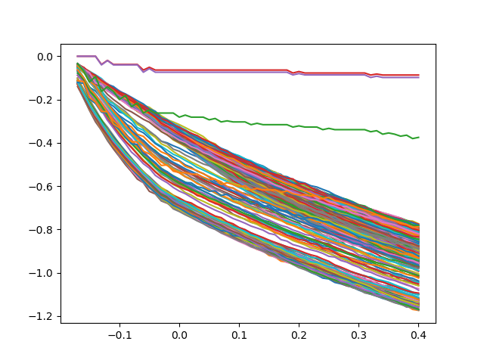
Changing sign and getting rid of multiplying it by 1e9 for plotting. Need to figure out units.
Manip 16
Manip 1

Slide 11
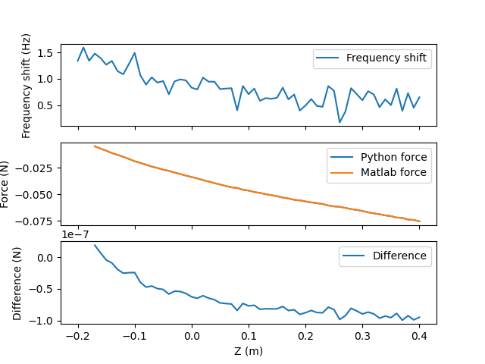
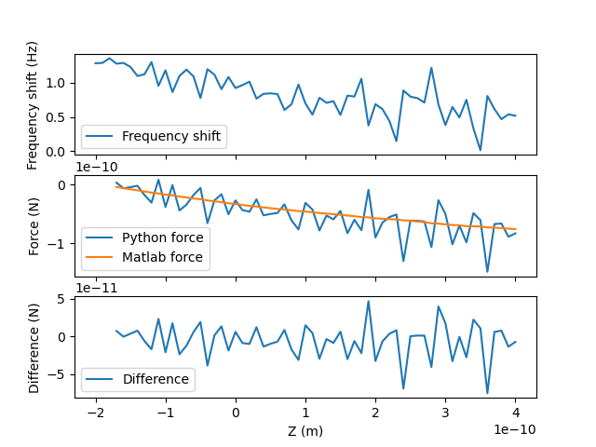

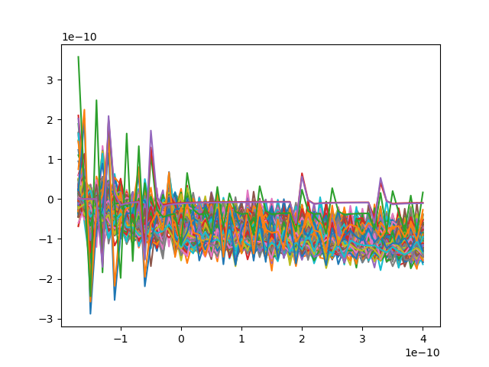
Found the X10 in freq shift will then shift it to have natural units in height as well as opposed to the nm units now
Clearly the natural units didn’t work BUT the matlab code did. Fascinating. Going to see if I can find the specific corr that causes it
Just removed 10x
Natural units.

Slide 12
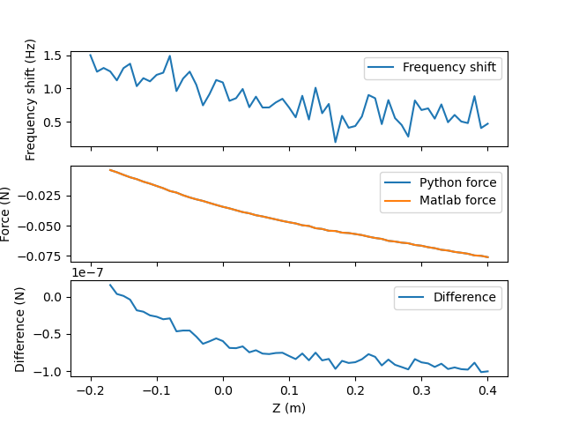

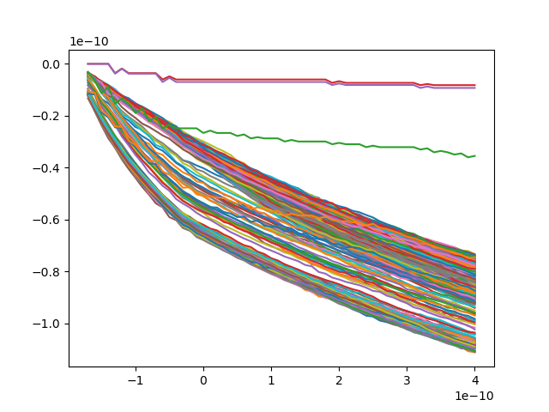
Going to check that if we go back to 1e9*force if it works and then will plot matlab force to check it.
matlab With natural units
Matlab force plotted

Slide 13
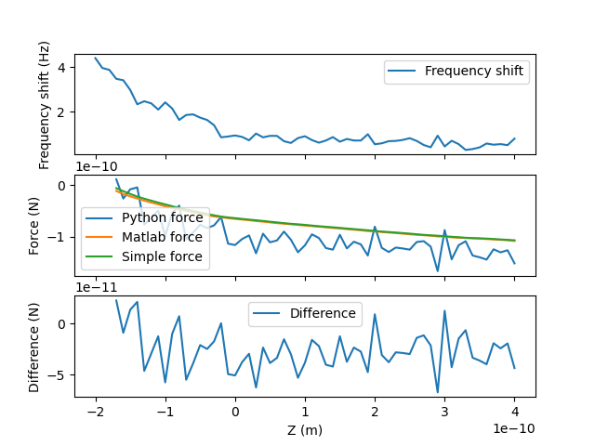
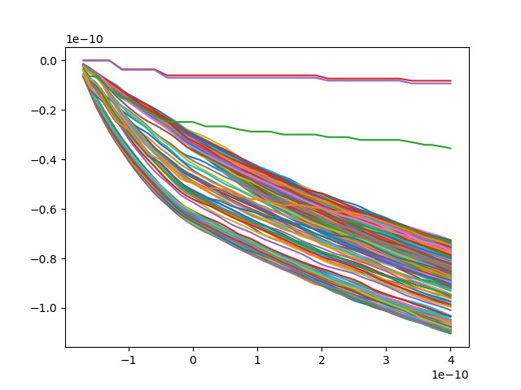
Checking out a simplified force calculation from water manipulation paper.

Slide 14
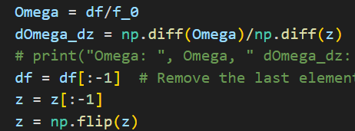
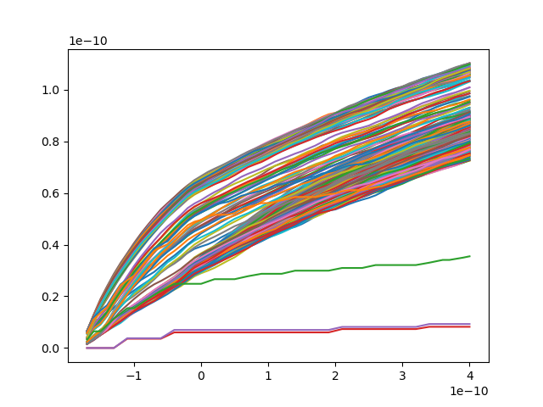
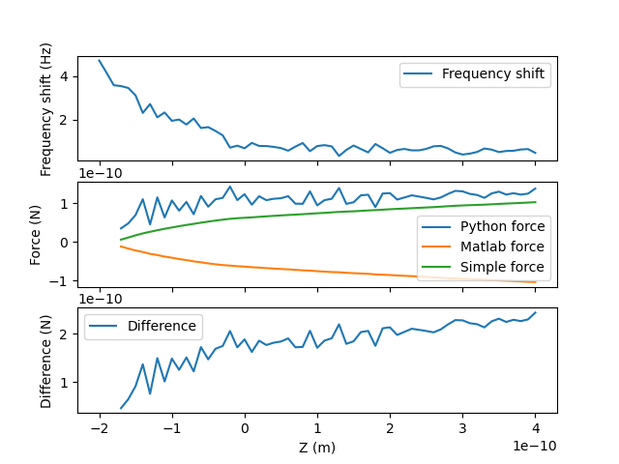
Okay so its consistently been going large to small forces… why? When it should go from 0 to a force as it gets closer. Try swapping flipping order of df

Slide 15
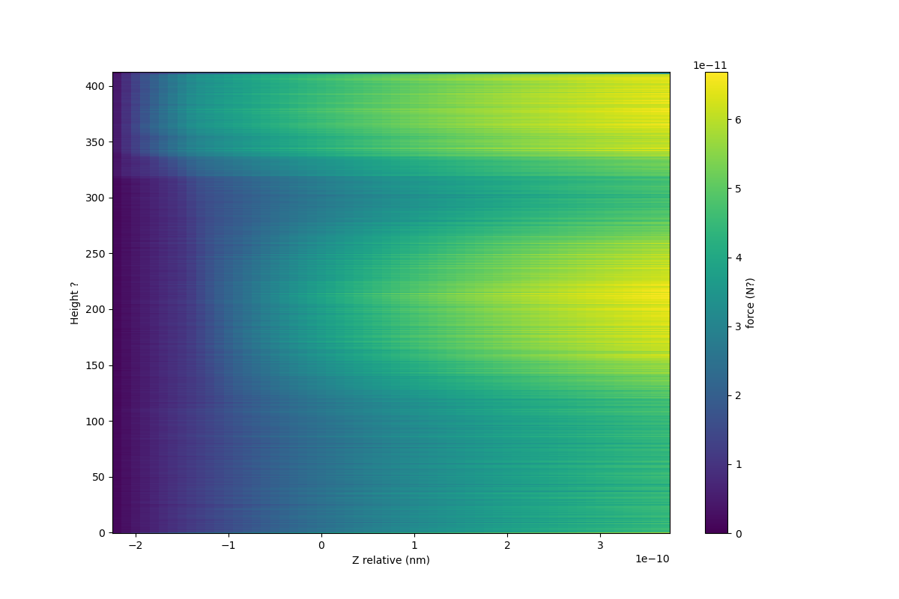
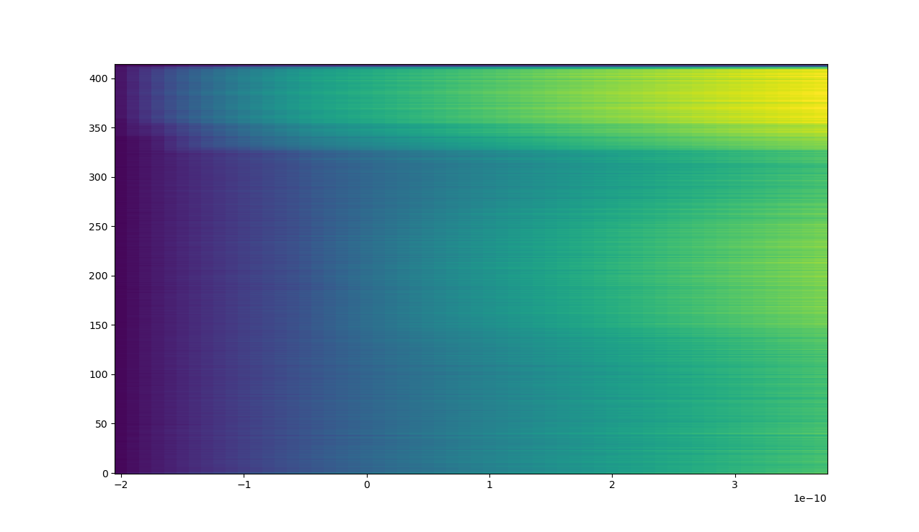
Hmm no dice. Should probably start looking at it all closer. Rather than plotting the graph lets turn it into a heat map
Okay wtf am I looking at so its height going down along the bottom R->L
And indices up the Y axis

Slide 16
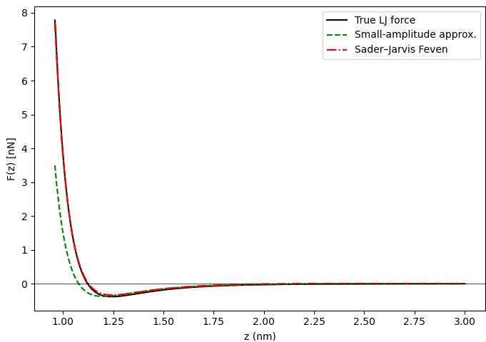
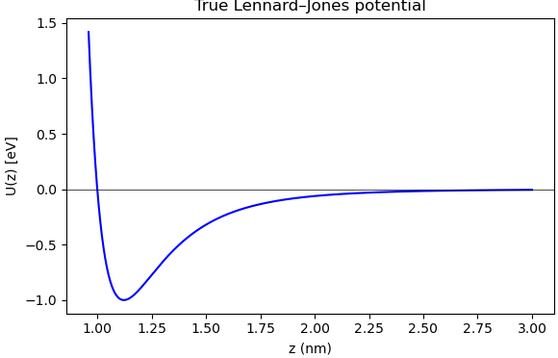
Including Phil’s code (Output from Phil’s code)

Slide 17
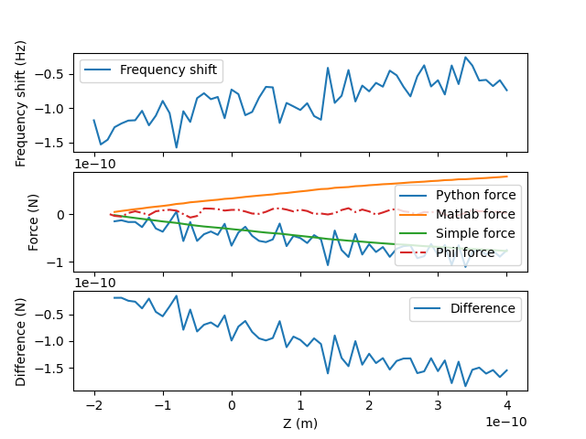
Interesting.. Its more similar to matlab code. Maybe just an OOM lower?

Slide 18
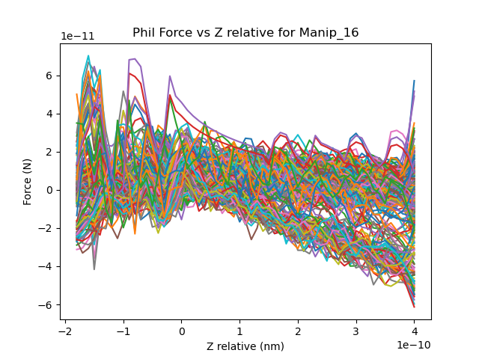
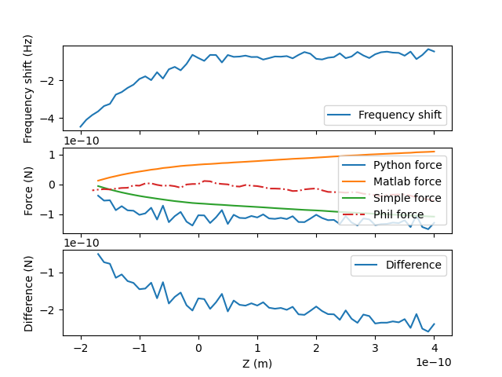
So got rid of df = -df so now back to basic and also plotting the phil stuff at the end as well to compare. Need to know if it’s a data processing or maths thing that causes offset.

Slide 19
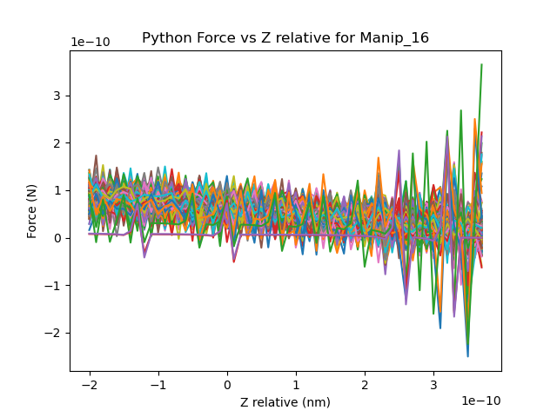
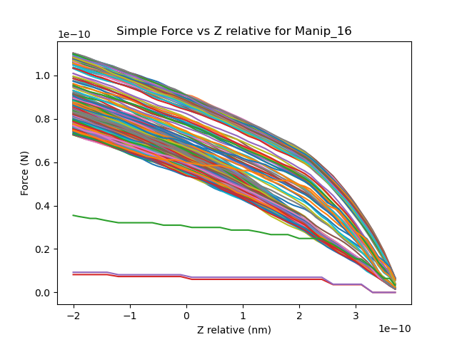
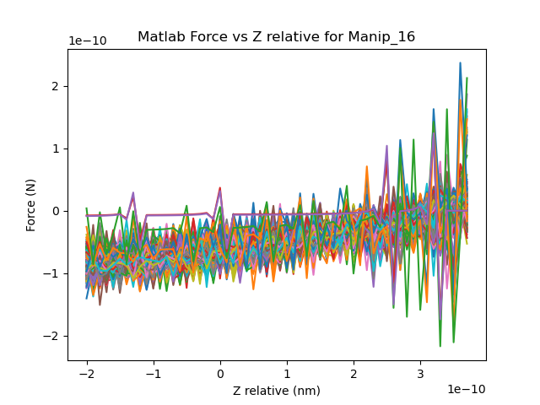
Flipped df. See if that fixes anything – Nope.
Flipped Z and…
Other graphs went to NaN

Slide 20
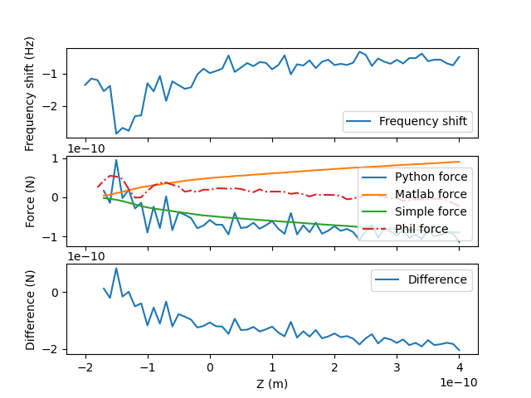
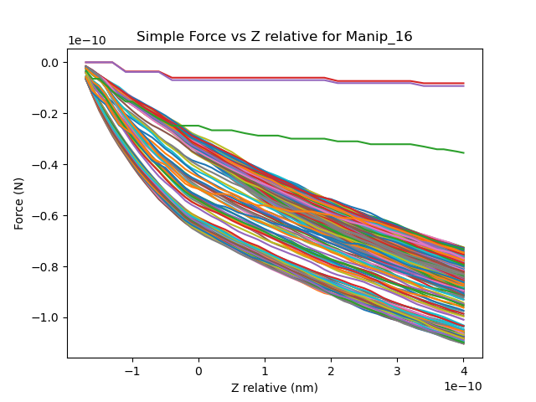
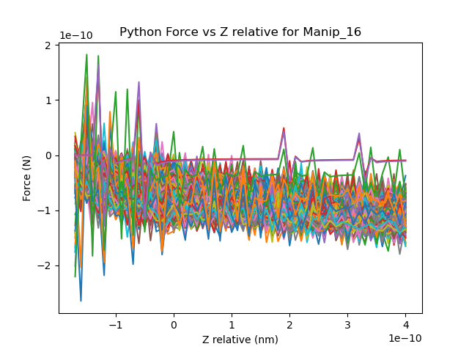
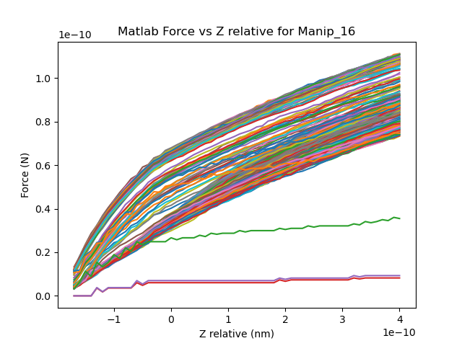
Reset back to initial settings so just normal data -> Will also start plotting theory force and see if I can get rid of weird stuff in the middle.

Slide 21
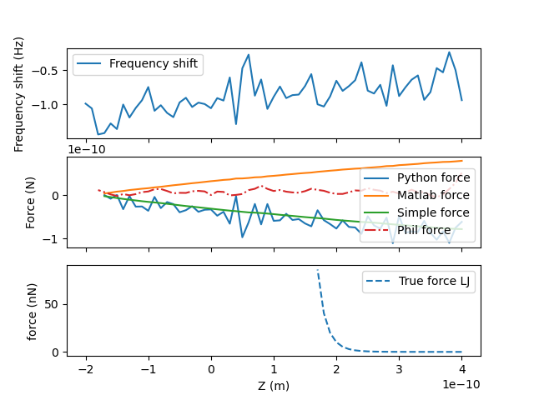

True force mask to get rid of points which are 1e187
Think these points are asymptotes at 0

Slide 22
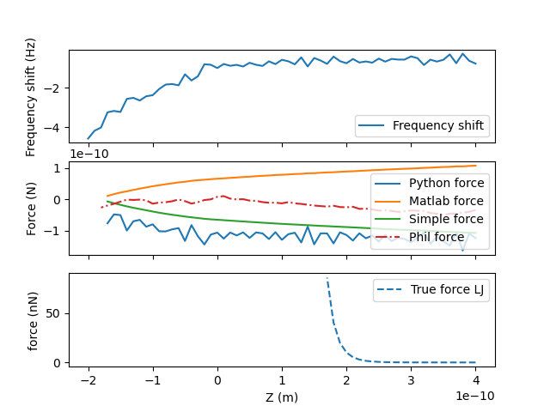
Okay we’re going to try and hand transpose it and see if that solves anything? Nope

Slide 23
Tried a few things and none worked
Flipped df and z at same time. Flipped them before and after omega calcs as well as flipping those as well and none fixed the issue

Slide 24
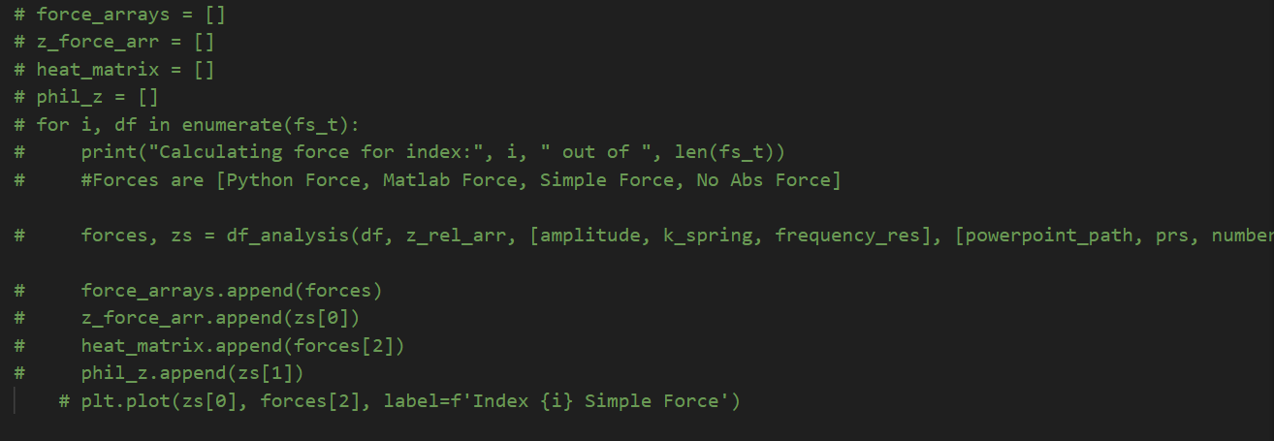
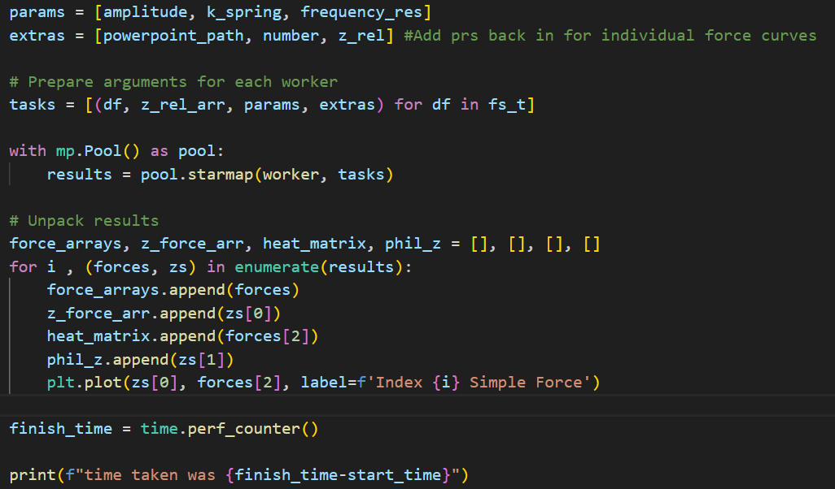
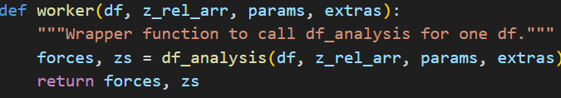
The hour analysis is killing me lets parallelise it
Previous:
Now:
(6th of
the time)
time taken was 3103.1173051999995
time taken was 520.9376511999999

Slide 25
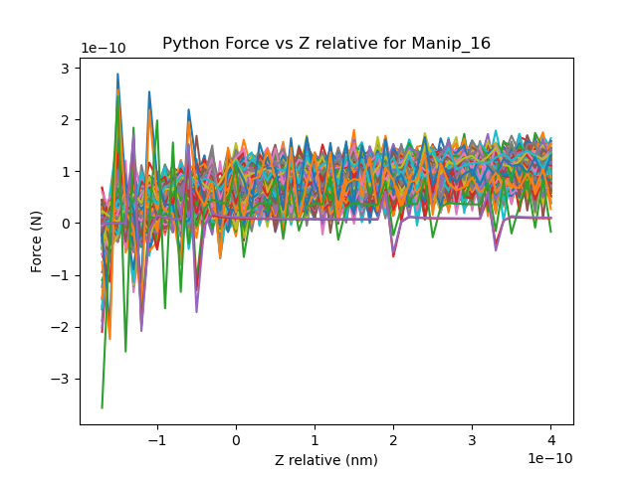

Graphs showing it matches previous

Slide 26

Python force without correction factors

Slide 27
No change by changing resonant freq up to 30k, amplitude up to 300pm also did nothing

Slide 28


Okay, Oli got it to work first time and bam, that motherfucker just works

Slide 29

Maybe it was the transposing… nope.

Slide 30


Flipped the z array

Slide 31


Flipped the df array

Slide 32


Okay so Oli is dealing with force stuff, I’m doing diffusion
20 bins, seems great
Example data file.

Slide 33


100 bins

Slide 34

750mv,… hmmmm -> its just not finding the point as the diff just doesn’t find anything.

